Slide 1

CleanHome
Convenient Service
Boyi Zhang

Slide 2
List
Team member
Project Introduction
Problem Statement
Personas
MVP demo
Technology tool
Diagram
Backlog
what to do next

Slide 3
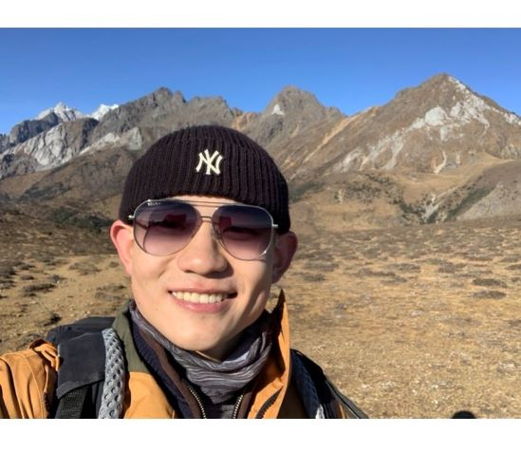
OUR TEAM
Responsible
product design
UI design
Implement project code
Collect user feedback
Ensure that the project meets user needs
Boyi Zhang
Product manager

Slide 4
INTRODUCTION
Cleanhome. As a convenient service platform, Cleanhome provides a one-stop housekeeping service for people's daily life, including cleaning, maintenance, gardening and other services.

Slide 5
Problem Statement
There are many problems with traditional Housekeeping services, such as difficulties make a appointment and guaranteeing service quality.
Aa one-stop service platform, we can solve most user needs, not just cleaning.

Slide 6
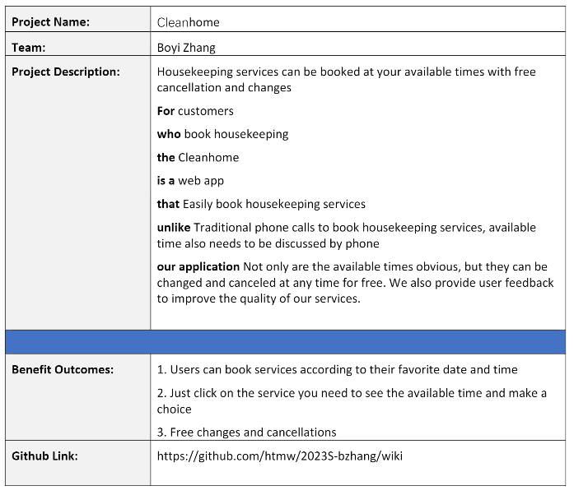
Project Description Summary

Slide 7
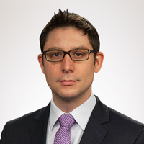
Persona 1
Demographics
Name: Oliver
Age: 35
Location: New York, NY
Job: Stock manager
Salary: $100,000-$120,000/year
Family: living alone
Profile
As an experienced stock manager, Oliver not only has to go to work on time every day, but also prepares for tomorrow's trading after get off work. Because of his work, he always likes to dress professionally and has a lot of suits at home.
Frustration
· He has a big apartment and doesn't have time to clean it.
· No time to take the suit to dry cleaning
Goals
· Need cleaning service
· Need to take the suit to dry cleaning

Slide 8

Persona 2
Demographics
Name: Anna
Age: 32
Location: New Jersey, NY
Job: Full time housewife
Salary: $0/year
Family: Lives with her husband and has three children
Profile
She lives in a house with his family. Every day, she cooks for her three children and her husband and cleans the house. Occasionally the yard needs to be cleaned.
Frustration
· The house is too big, it's tiring to clean it every time.
· When cleaning the garden, the tools are too heavy for her to clean
· Cleaning takes too much time every time and needs some time to do her own interests
Goals
· Cleaning services are needed to clean part of the home
· Need to clean the weeds and water the garden

Slide 9
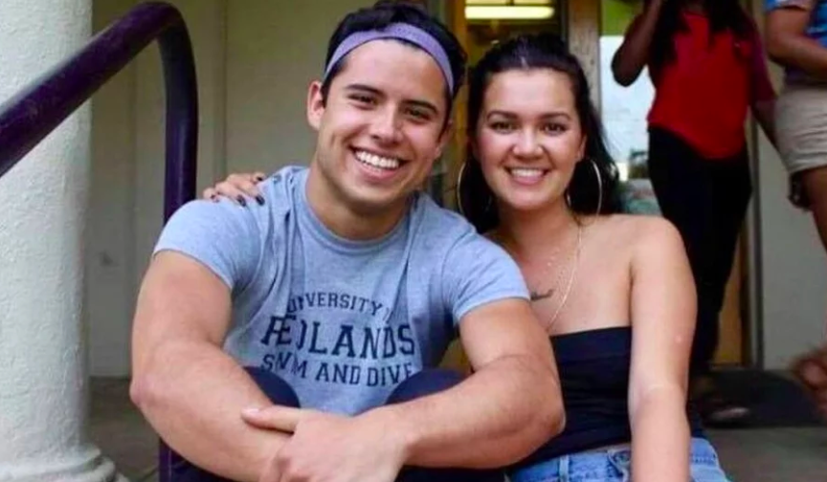
Persona 3
Demographics
Name: Frank
Age: 25
Location: New York, NY
Job: Bank employee
Salary: $48,000-$60,000/year
Family: Lives with his girlfriend and a dog
Profile
As a fresh graduate, he needs to go to the bank to work on time every day. But sometimes because of work, it is necessary to exchange to a bank in another place. Her girlfriend is studying at NYU. He and his girlfriend live in a rented house in New York. They have a dog together.
Frustration
· Moving and cleaning is too tiring, he doesn't want to do it himself
Goals
· Need cleaning service after they move
· Clean the newly rented apartment

Slide 10
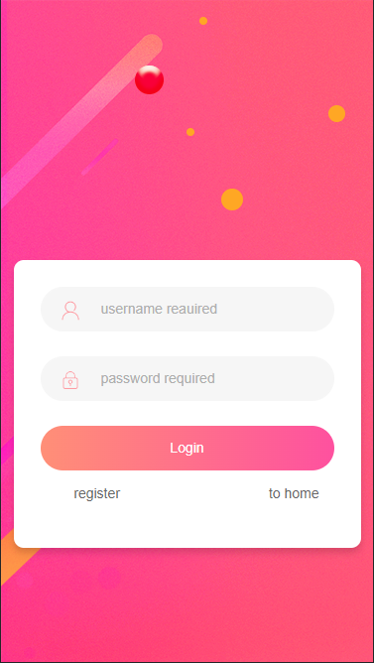
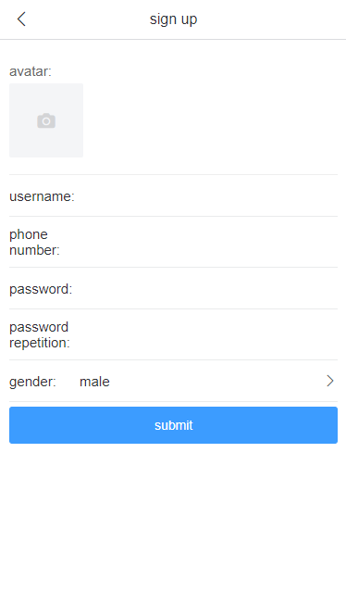
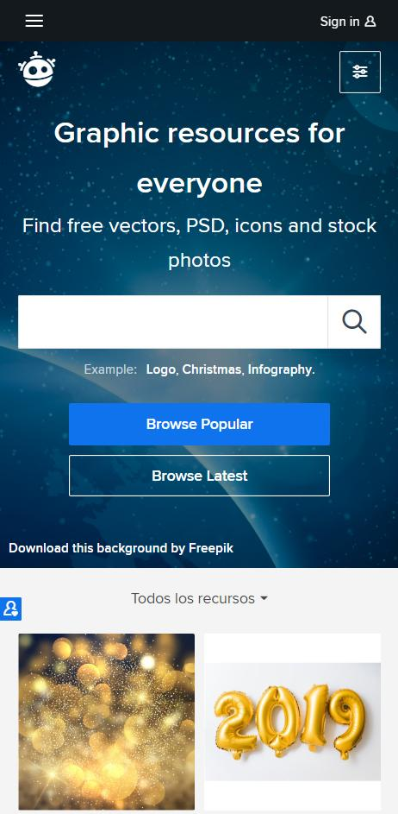
MVP DEMO
Login page
Signup page

Slide 11
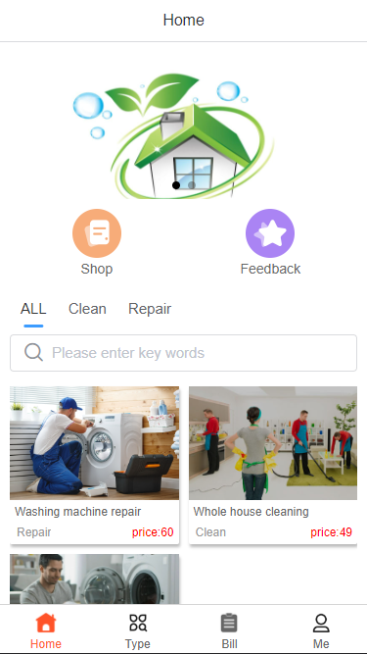
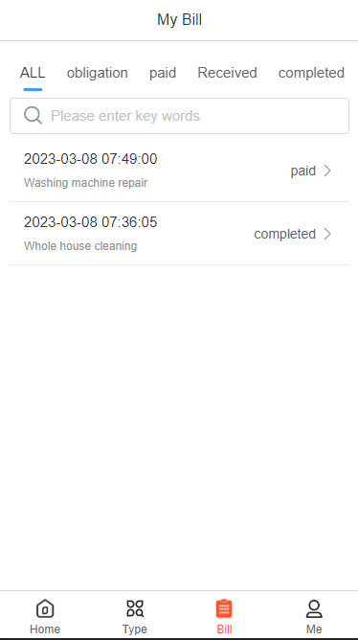
MVP DEMO
Home page
Order page

Slide 12
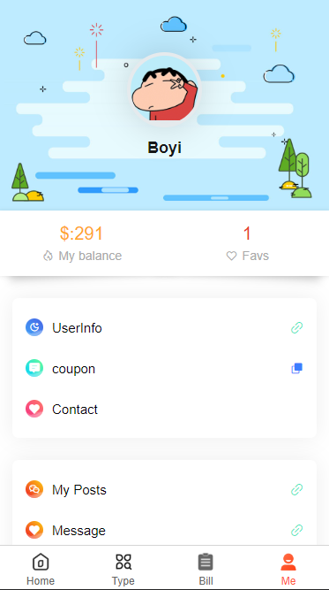
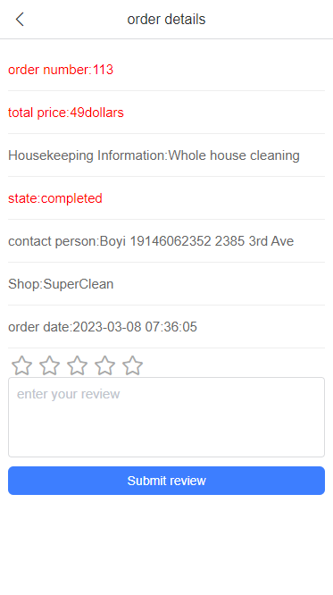
MVP DEMO
Profile page
Feedback page

Slide 13

Technology Tools

Slide 14
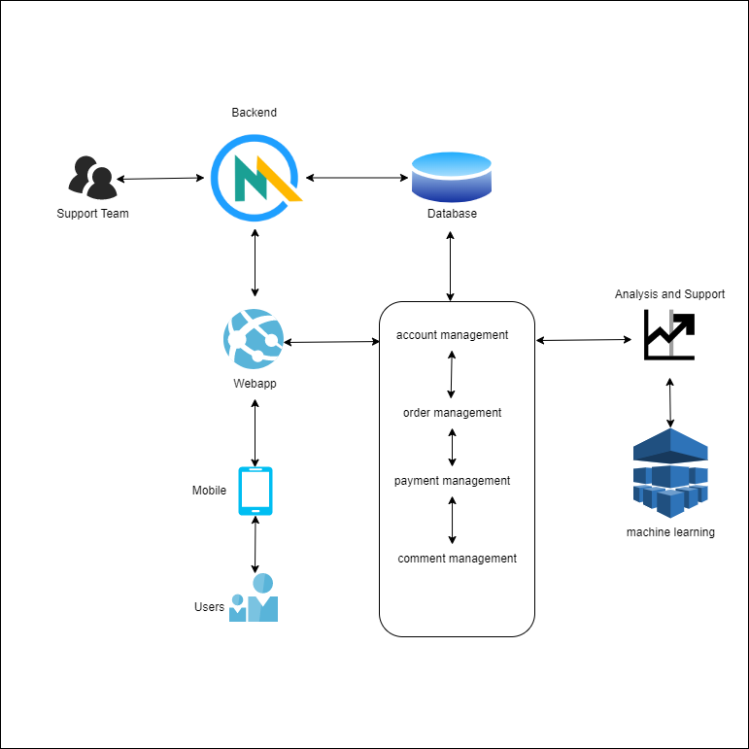
Conceptual Diagram

Slide 15
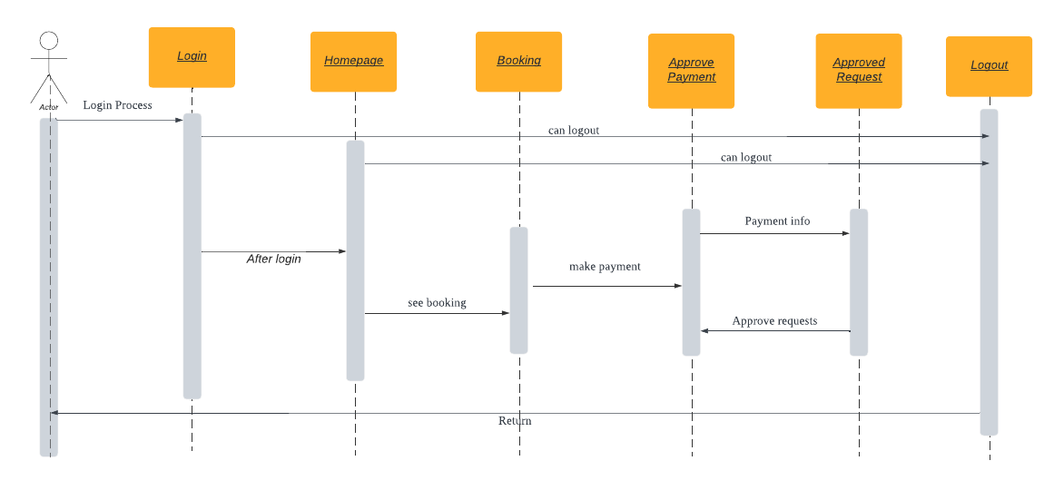
Sequence Diagram

Slide 16
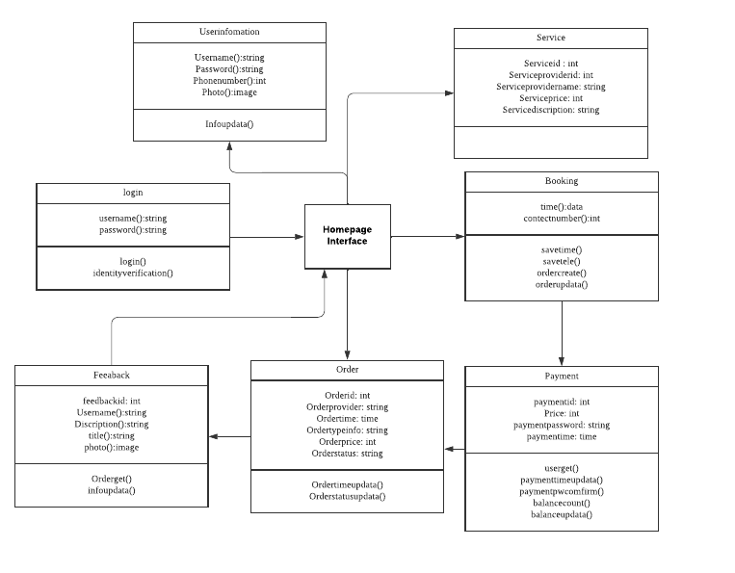
Class Diagram

Slide 17
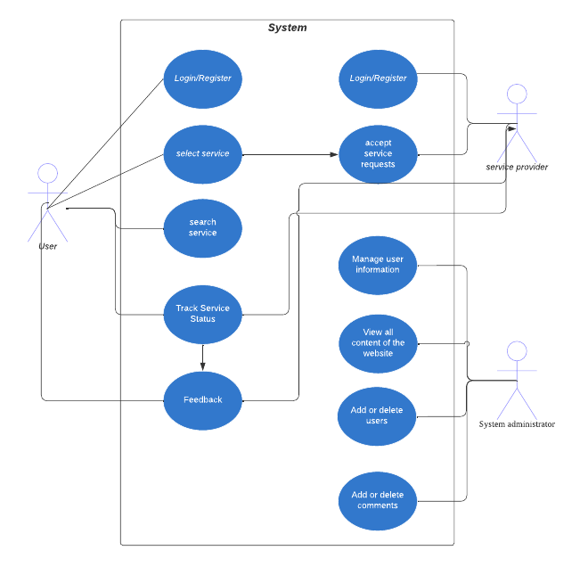
Use Case Diagram

Slide 18
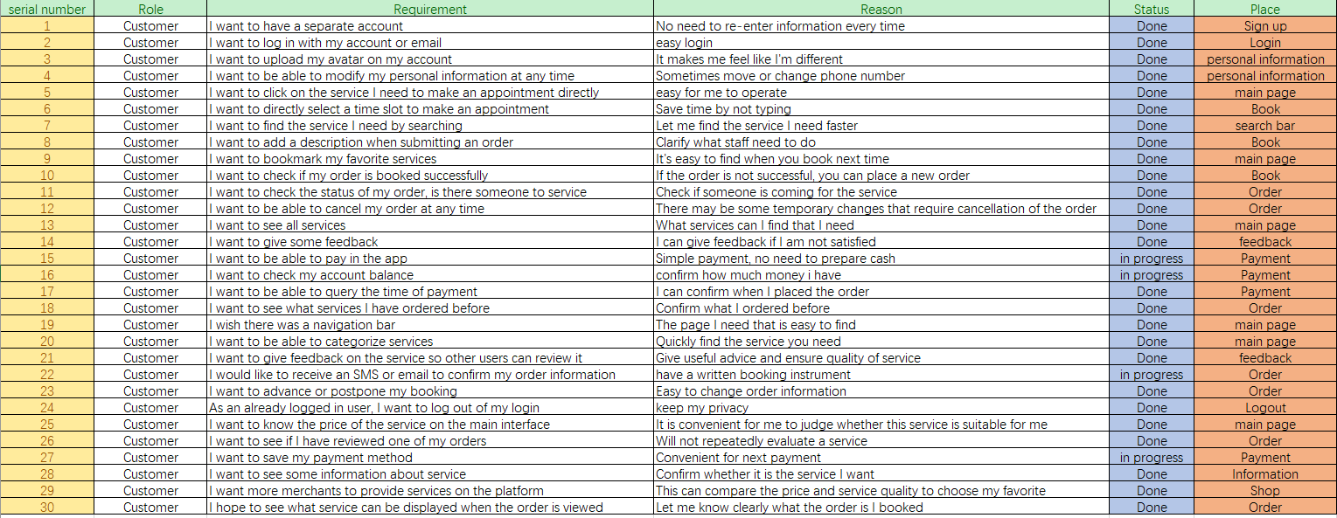
User Stories

Slide 19
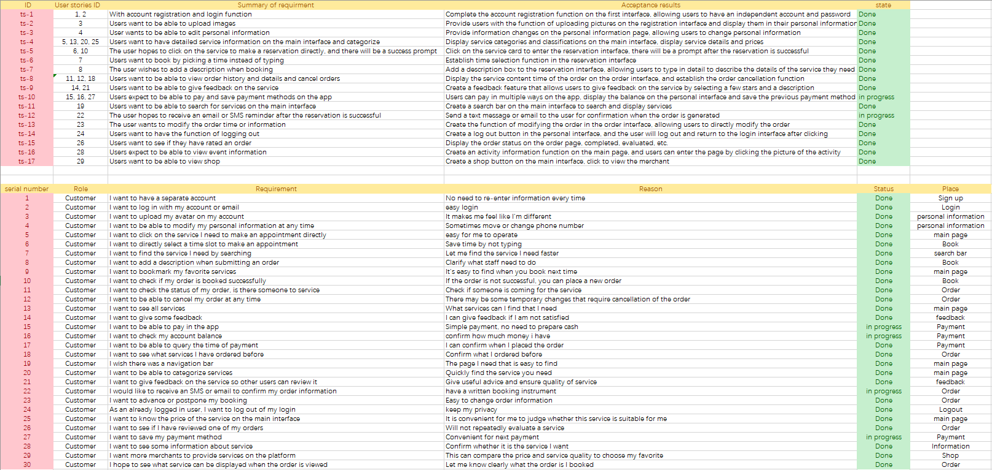
Acceptance Criteria

Slide 20
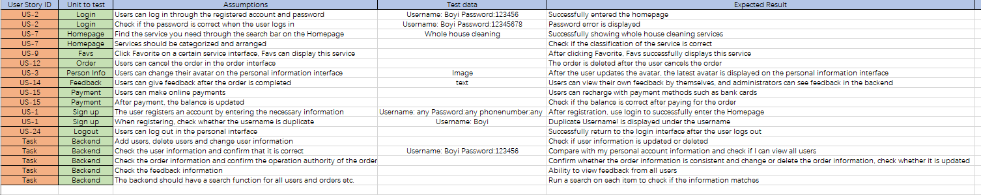
Test Case

Slide 21
Sprint 1 backlog

Slide 23
Sprint 1 Burndown Charts

Slide 24
Program Completion
Total: 47
Complete: 42
Undone: 5
task completion: 89%
89%
Complete
11%
Undone

Slide 25
What went well?
Completed most of the mission plans
Followed the rules of agile programming
Minimal Viable Product achieved

Slide 26
what can be improved?
Keep the version update on github
make the plan better
Complete the plan on time

Slide 27
What to do next?
Analyze User Behavior Habits with ML
Complete previous unfinished tasks
Optimize project UI and functions
Planning for Sprint 2 with paper work

Slide 28
MVP App screenshots

Slide 29
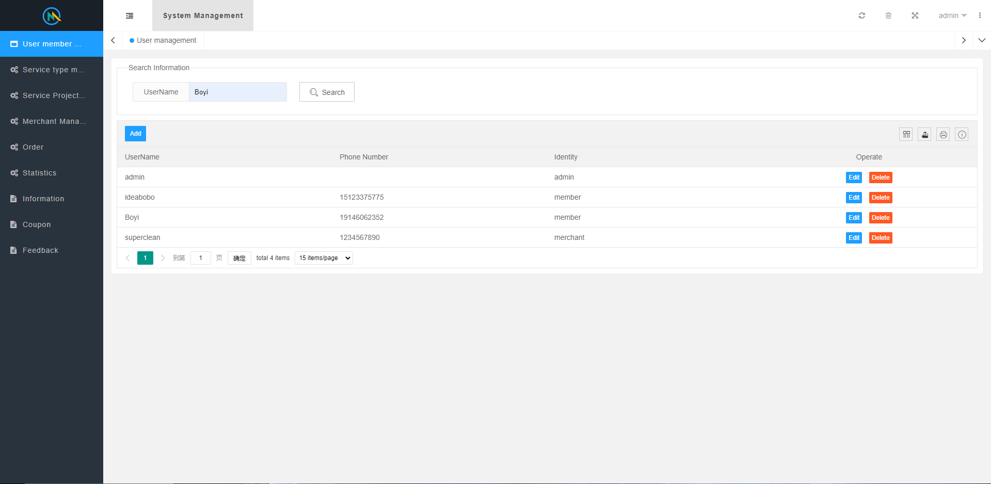
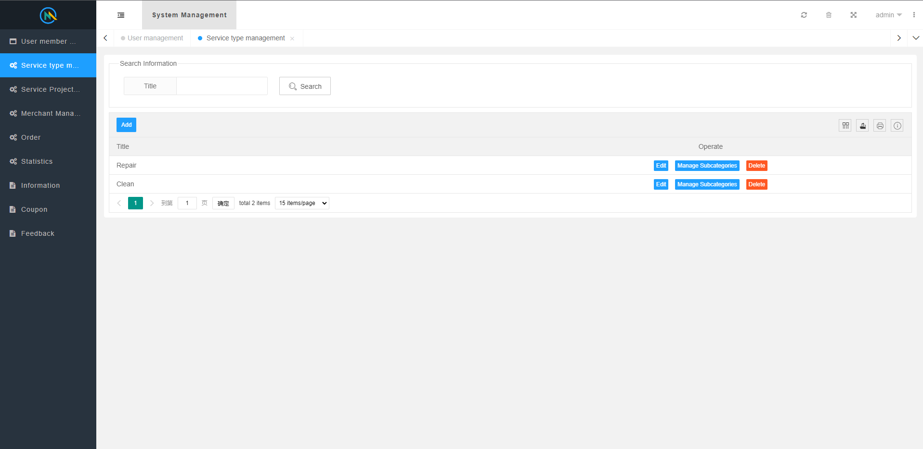
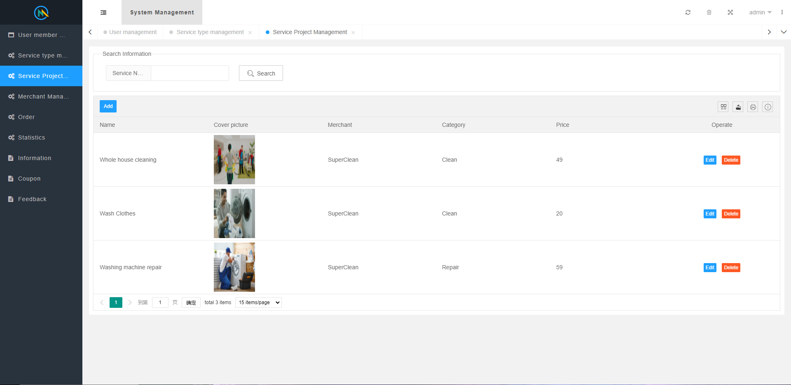
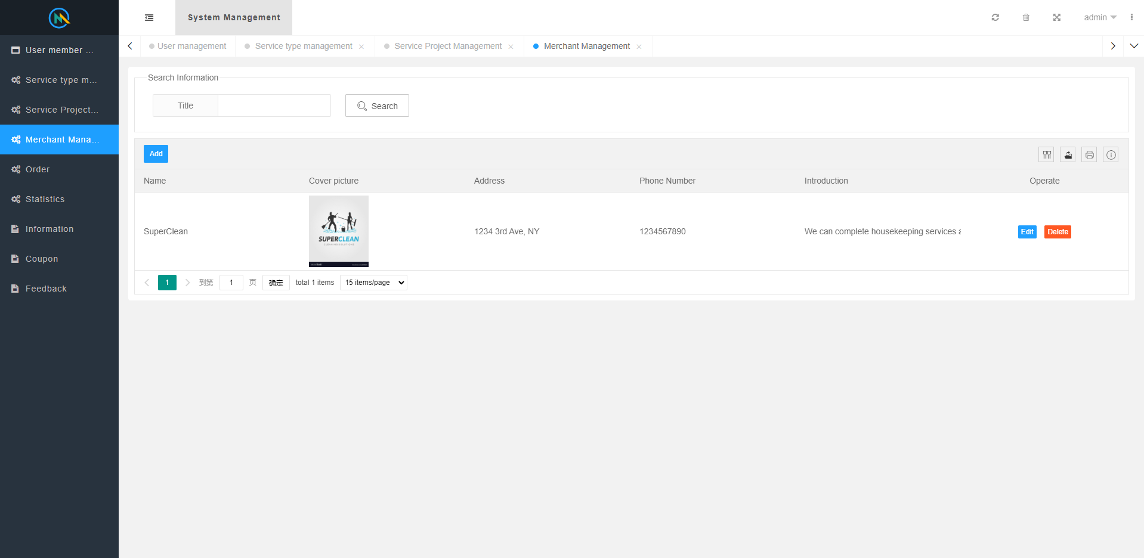
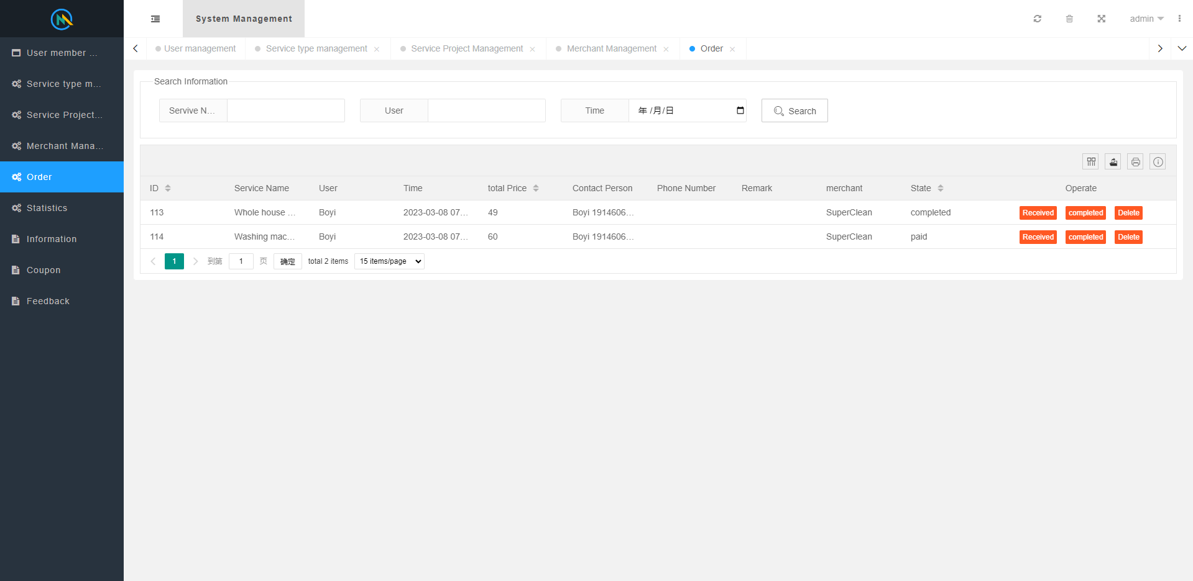
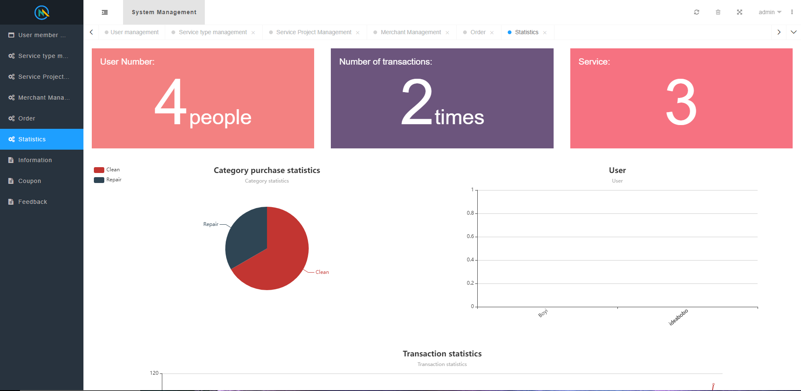
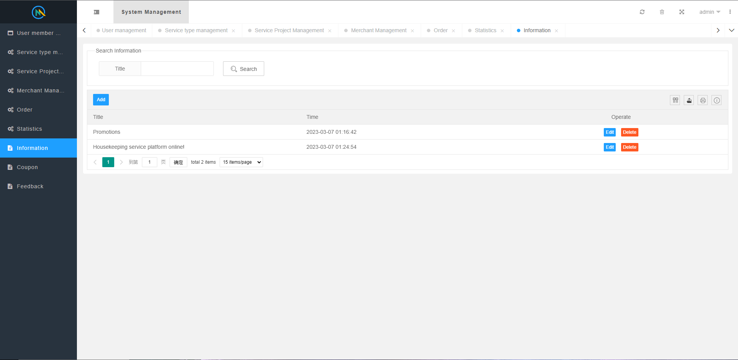
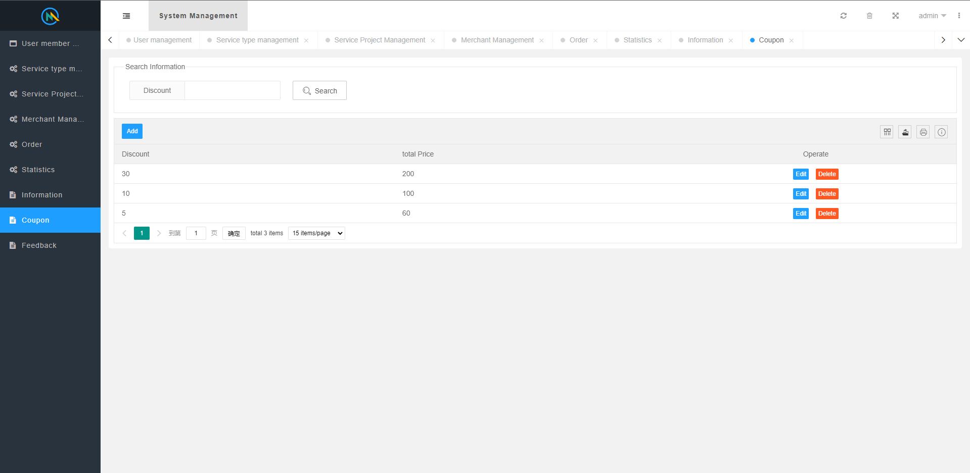
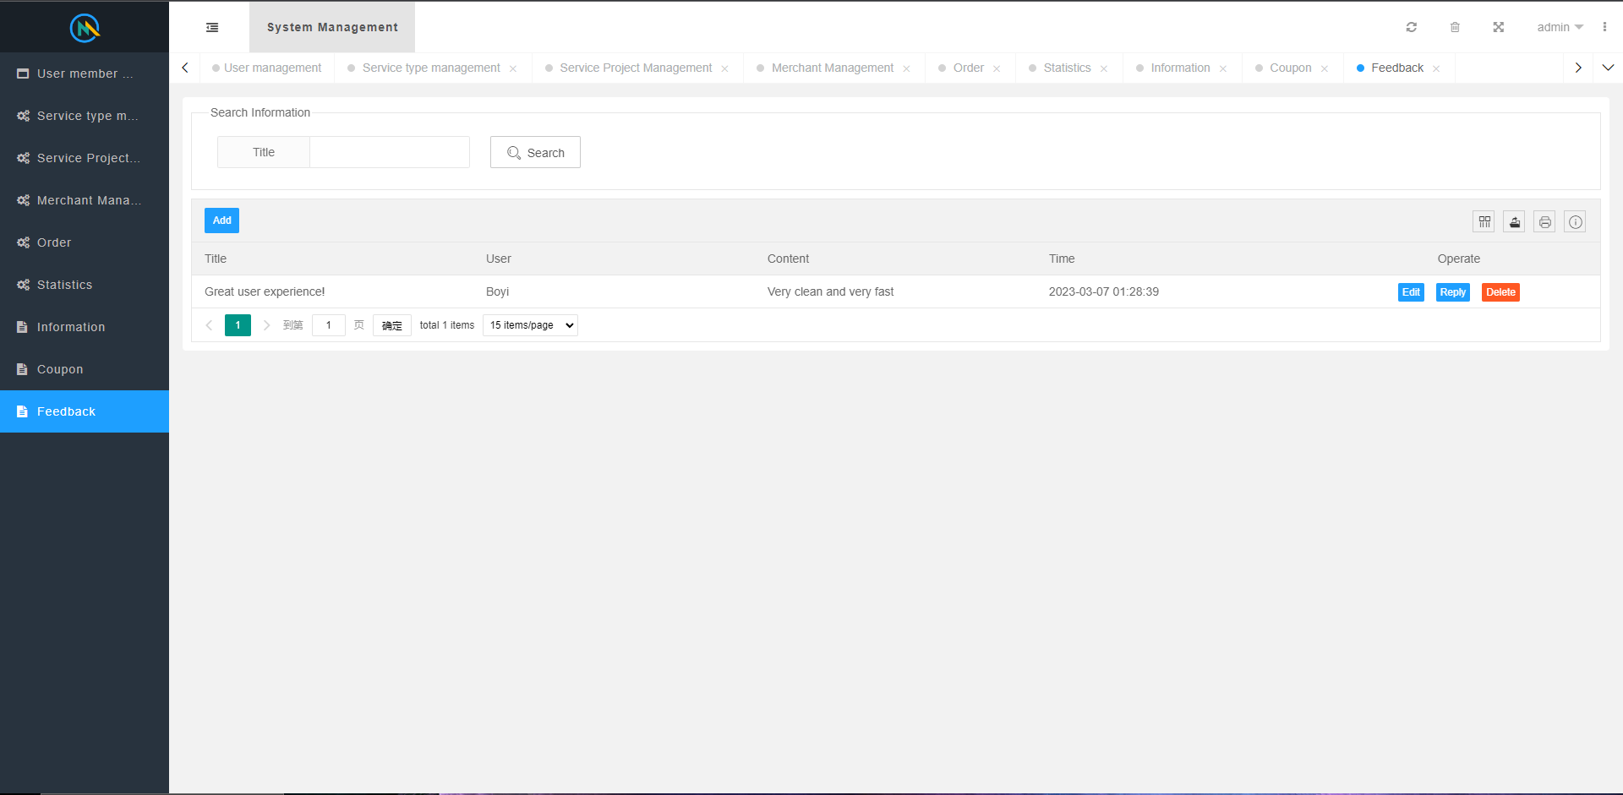
MVP API screenshots

Slide 30
Link
Github: https://github.com/htmw/2023S-bzhang/wiki
MVP Demo video: https://youtu.be/zfEO-UfZSYw

